Slide 1

Quick tutorials for Git, $LaTeX$ and Zotero
Hao Wang
https://waynehfut.com
2020/11/23

Slide 2
Git
Git installation
Git configuration
Git repository
Git commit, pull and push
.gitignore
Rollback
Branch
Private repository

Slide 3
Git installation
Windows:
Git-SCM: https://git-scm.com/
Github Desktop: https://desktop.github.com/
Linux and MacOS:
via apt: sudo apt install git
(Defaulted install in the Unix and Linux)

Slide 4
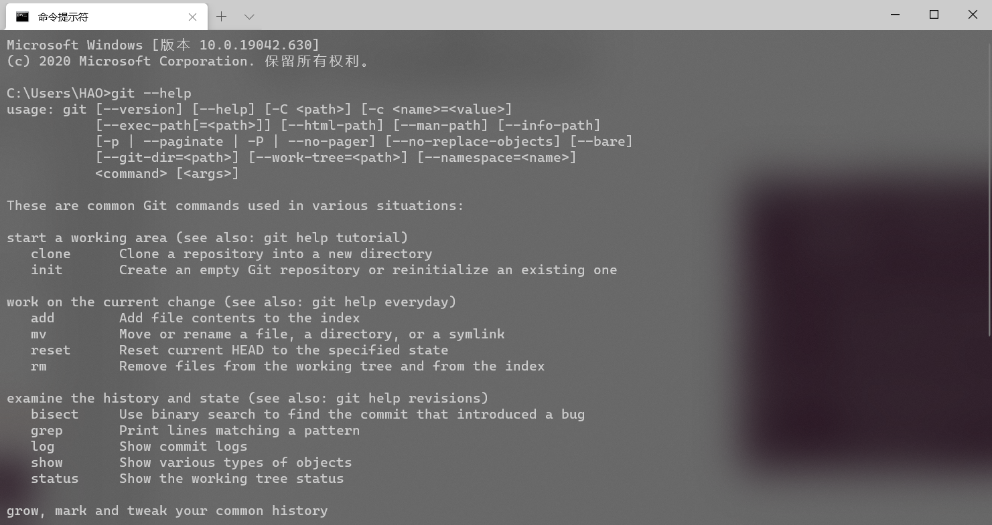
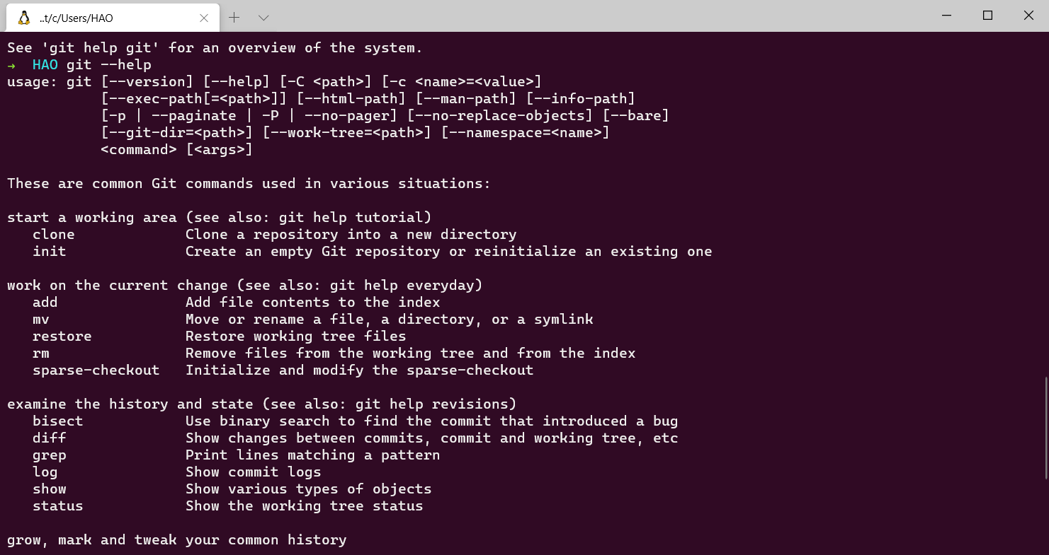
Git installation
Windows (cmd)
Ubuntu (bash)

Slide 5
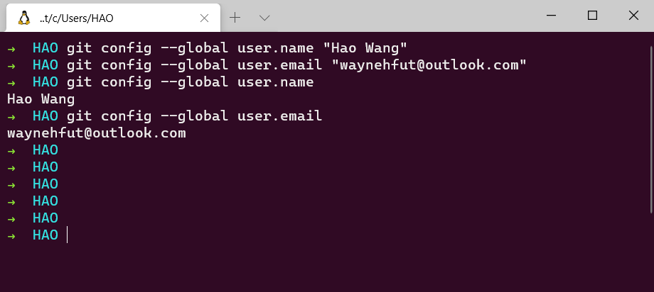
Git configure personal infomation
git config --global user.name "Hao Wang"
git config --global user.email "waynehfut@outlook.com"

Slide 6
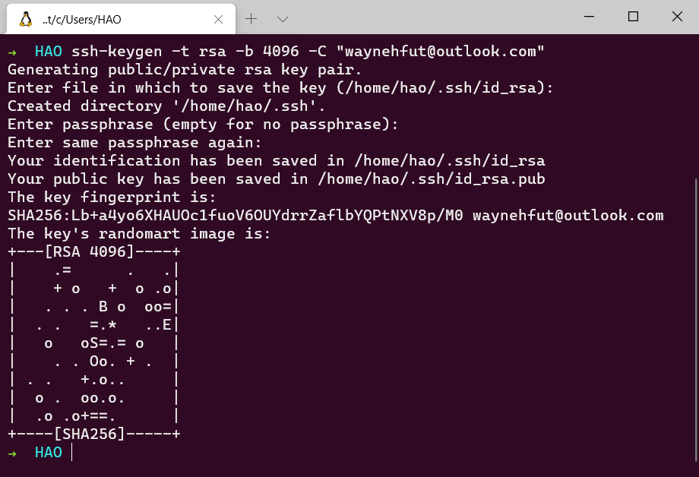
Git configuration ssh
ssh-keygen -t rsa -b 4096 -C "waynehfut@outlook.com"

Slide 7
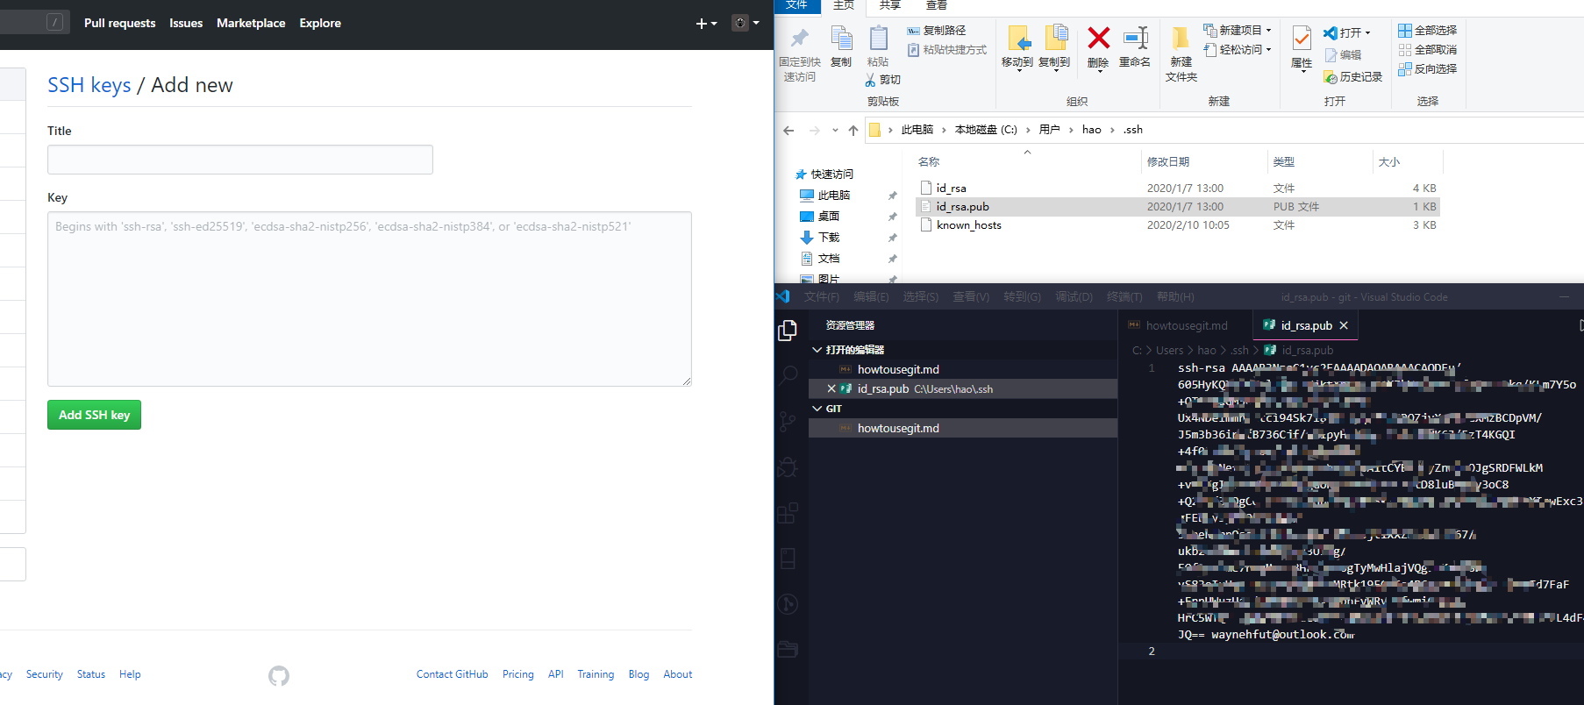
Git configuration ssh
Add id_rsa.pub to the remote platform (such as github)
Open https://github.com/settings/keys
Click add new key and paste the content from id_rsa.pub

Slide 8
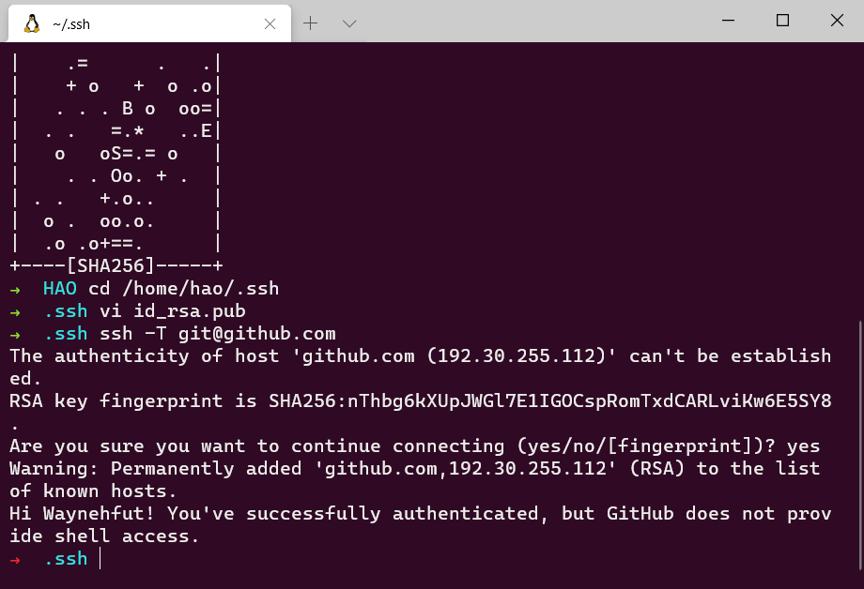
Git configuration ssh
Test ssh connection
ssh -T git@github.com
Are you sure you want to continue connecting (yes/no/[fingerprint])? yes

Slide 9
Git repository
Two way to create a repo
Via web
Via local init

Slide 10
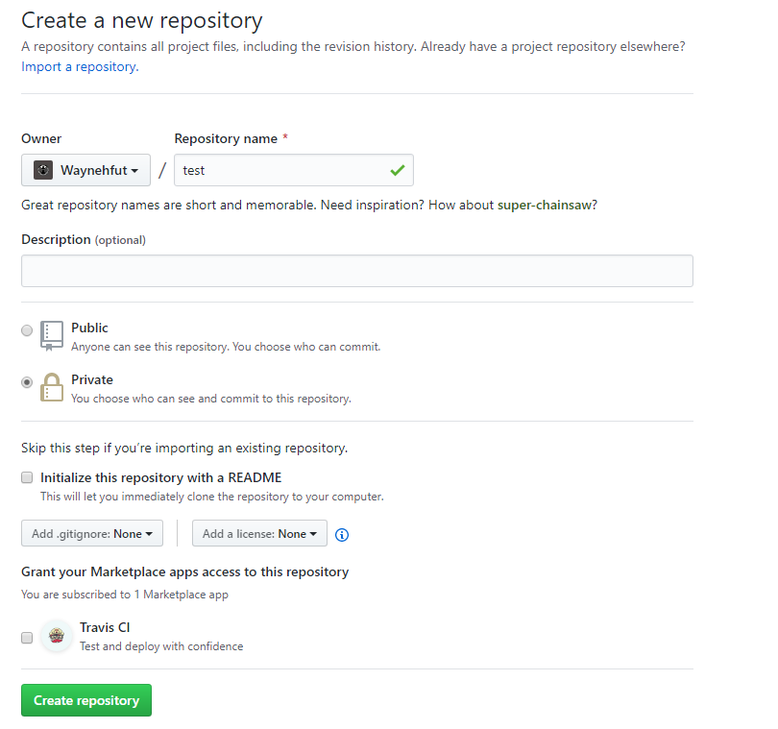
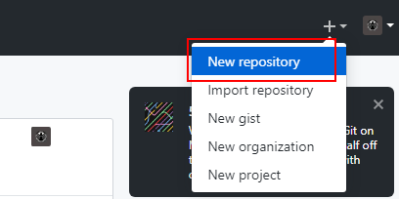
Create repo via web

Slide 11
Create repo via local init
git init # Setup current work folder as repo
git add -A # Add all file as git track files
git commit -m "first commit" # commit current status to the git local head and with message `first commit`
git remote add origin git@github.com:Waynehfut/test.git # add remote repo
git push -u origin master # push local head to the remote repo

Slide 12
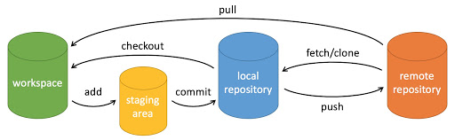
Git commit, pull and push
git commit -m "first commit" # commit current status to the git local head and with message `first commit`
git pull <remote-branch> # pull most recent update to local worktree
git push <remote-branch> <local-branch> # push most recent committed change to the remote repo
https://www.runoob.com/git/git-basic-operations.html

Slide 13
.gitignore
Some files you don’t want to track, you can:
Identify the list manually
Generate by the template

Slide 14
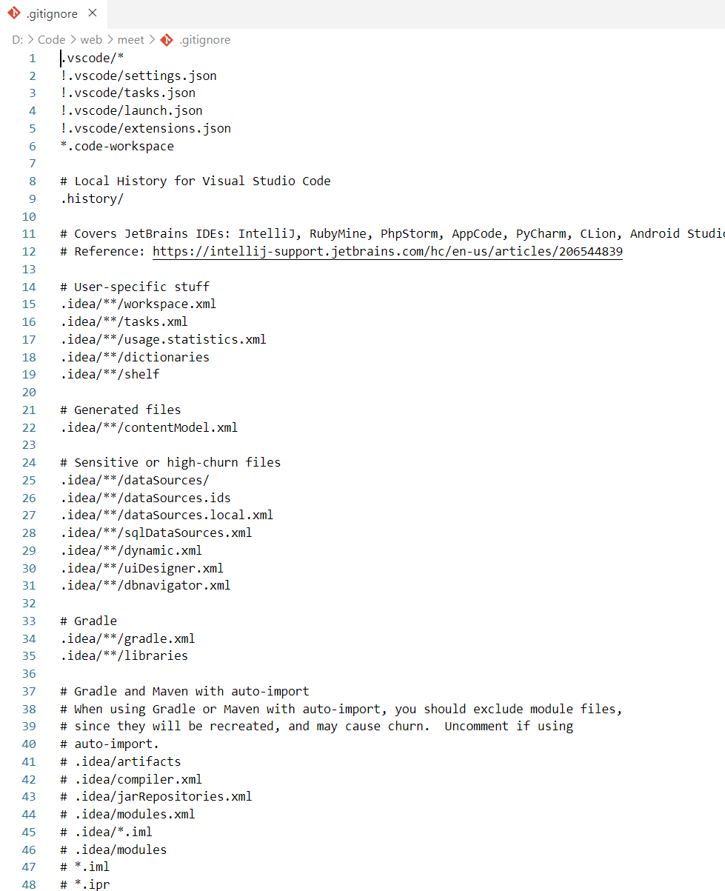
.gitignore
Manual:
Regular expression
Template:
https://github.com/github/gitignore
https://github.com/JetBrains/idea-gitignore
https://github.com/toptal/gitignore

Slide 15
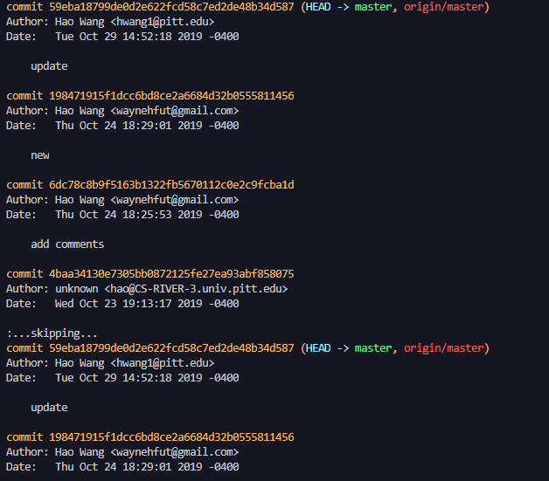
Rollback
Not push yet
git reset HEAD <fileName>
# cancel the commit for <fileName>
git checkout <fileName>
# rollback <filename> to previous status
Pushed
git log
Git revert <commitID>

Slide 16
Branch
git branch # check current branch status
git branch (branchname) # create new branch
git checkout (branchname) # switch to new branch
git checkout -b (branchname) # create and switch to new branch
git branch -d (branchname) # delete new branch
git merge (branchname) # merge (branchname) to current branch
https://www.runoob.com/git/git-branch.html

Slide 17
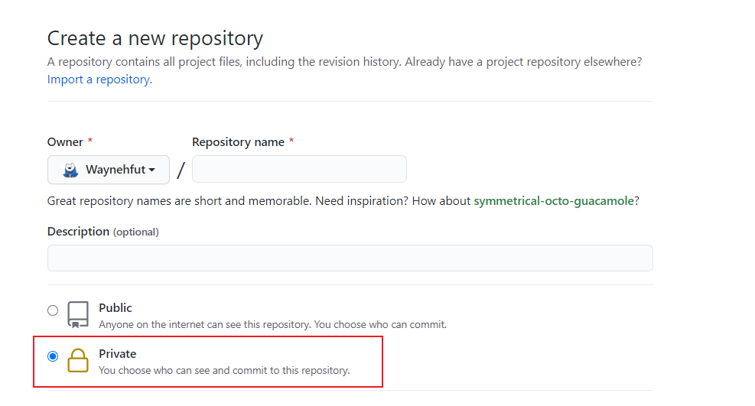
Private repository
Both github and gitlab support the private repository for free.

Slide 18
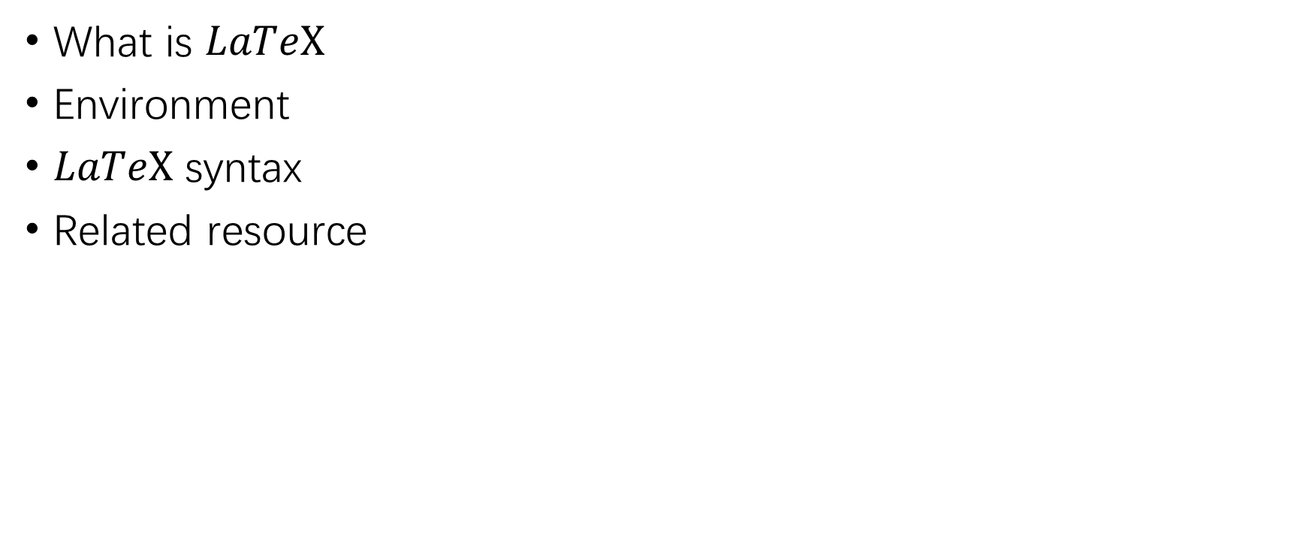

$$LaTeX$$
What is $LaTeX$
Environment
$LaTeX$ syntax
Related resource

Slide 19
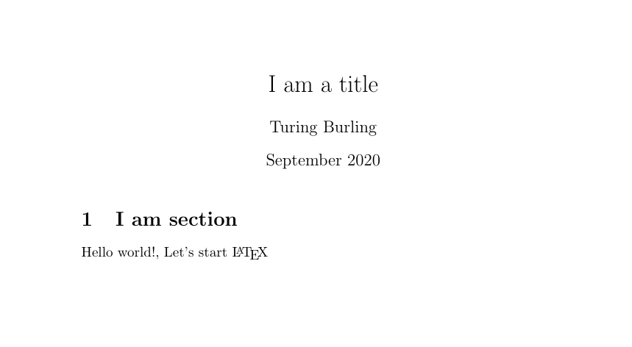

What is $LaTeX$
/ˈlɑːtɛk/ or /ˈleɪtɛk/
\documentclass{article} \title{I am a title} \author{Turing Burling} \date{September 2020} \begin{document} \maketitle \section{I am section} Hello world!, Let's start \LaTeX \end{document}

Slide 20
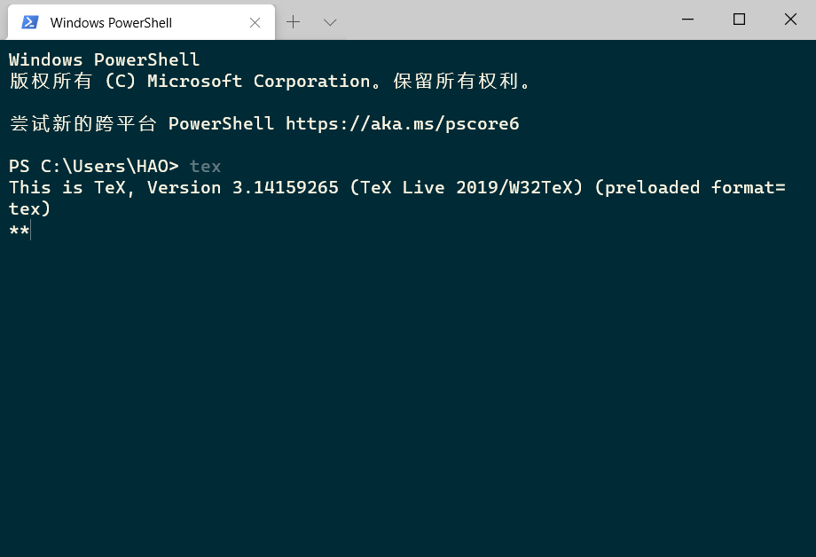
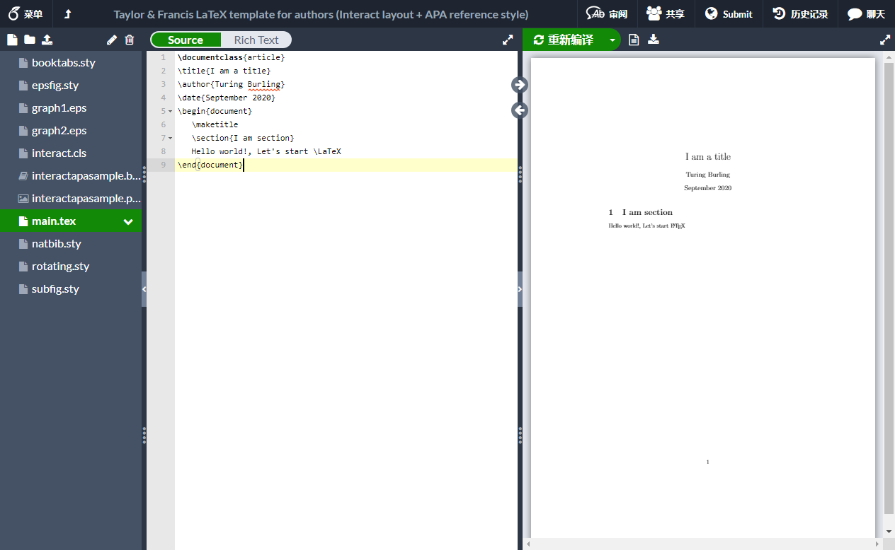
Environment
Local environment is not recommended,
consider using https://www.overleaf.com/
If you want install Latex on your computer
Windows and linux, TexLive: https://www.tug.org/texlive/
MacOS, MacTex: https://www.tug.org/mactex/

Slide 21
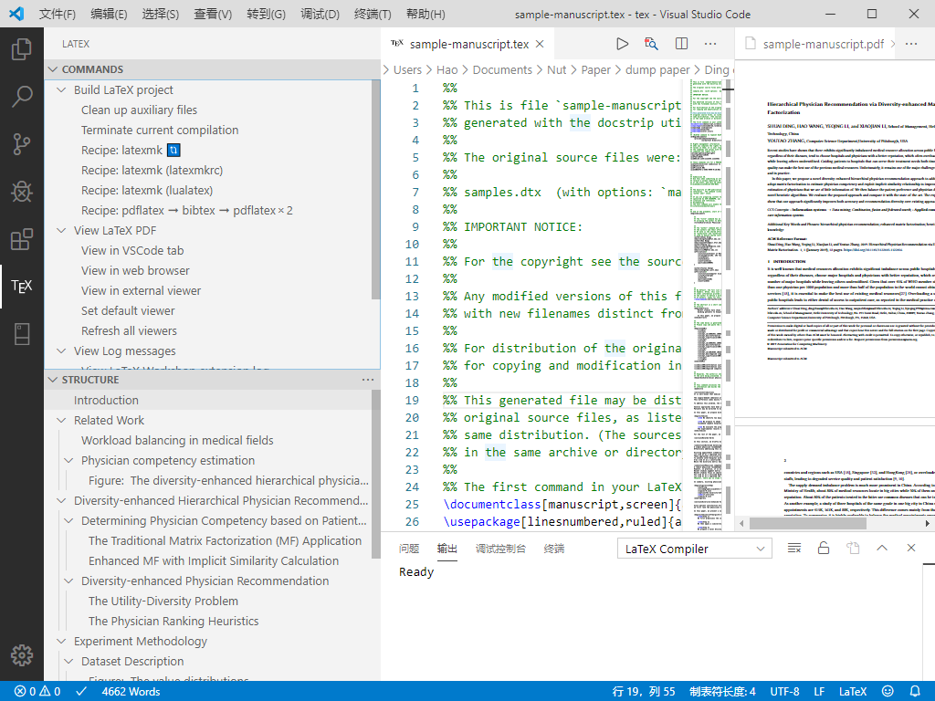
Environment
Using offline
TexStudio
VSCode Latex Workshop
mirrors.tuna.tsinghua.edu.cn
mirrors.ustc.edu.cn

Slide 22
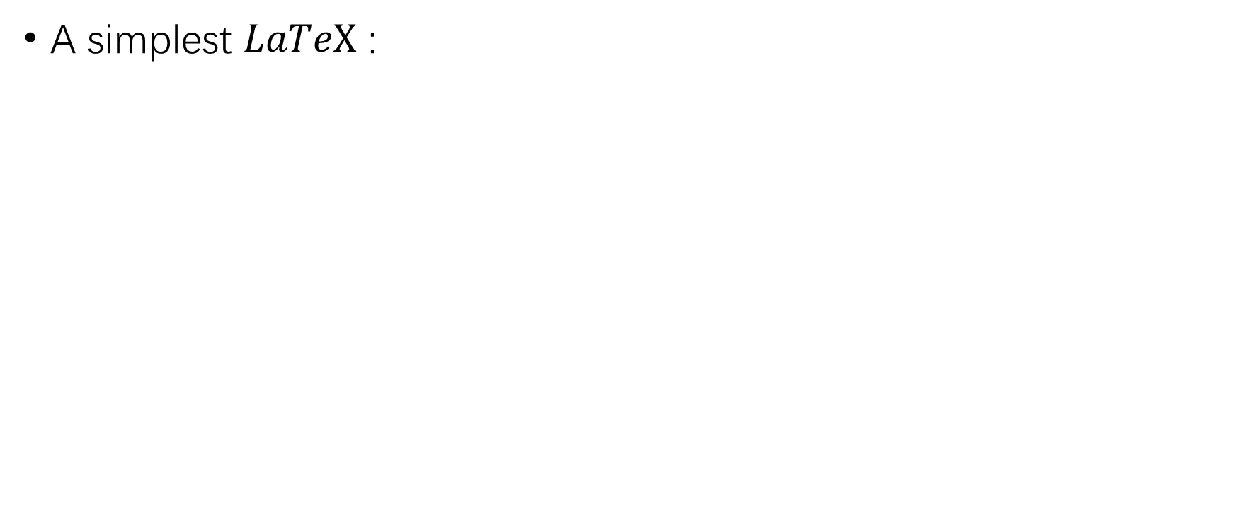

$LaTeX$ syntax
A simplest $LaTeX$ :
\documentclass{article} %Document type \title{Title} %Document title \begin{document} %Main body \maketitle %Make title Hello world!, Let’s start \LaTeX %Simple paragraph \end{document} %End document

Slide 23

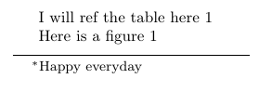
$LaTeX$ syntax
Affiliation and footnote:
\usepackage{authblk}
\renewcommand\Affilfont{\itshape\small} \author[1]{Hao~Wang, Sherleen~Zhu \thanks{Happy everyday}}% \author[2]{Turling Burling} \affil[1]{Hefei University of Technology} \affil[2]{University of Pittsburgh} \maketitle

Slide 24
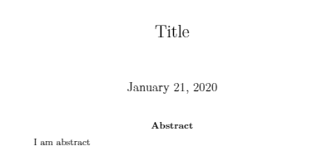
$LaTeX$ syntax
Abstract:
\begin{abstract} I am abstract \end{abstract}

Slide 25
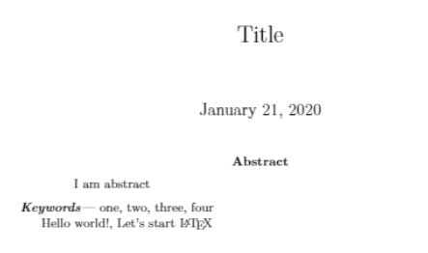
$LaTeX$ syntax
Key words:
Most journal template provide the keywords syntax, here we identify a simplest format.
\providecommand{\keywords}[1] % { \small \textbf{\textit{Keywords---}} #1 } \keywords{one, two, three, four}

Slide 26
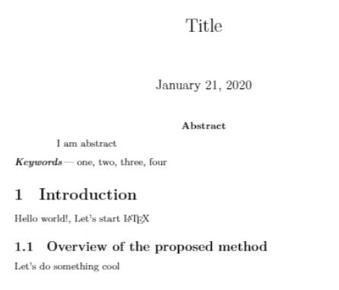
$LaTeX$ syntax
Section:
\section{Introduction} \subsection{Overview of the proposed method}

Slide 27
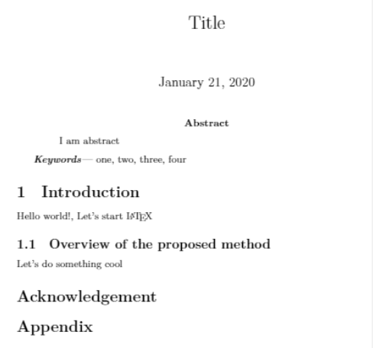
$LaTeX$ syntax
Appendix:
\section*{Acknowledgement} \section*{Appendix}

Slide 28
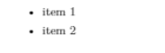
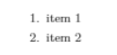
$LaTeX$ syntax
List:
\begin{itemize} \item item 1 \item item 2 \end{itemize}
\begin{enumerate} \item item 1 \item item 2 \end{enumerate}

Slide 29
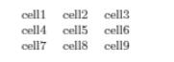
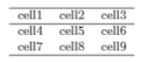
$LaTeX$ syntax
Table:
\begin{table}[] \begin{tabular}{ c c c } cell1 & cell2 & cell3 \\ cell4 & cell5 & cell6 \\ cell7 & cell8 & cell9 \end{tabular} \end{table}
\begin{table}[] \begin{tabular}{ c c c } \hline cell1 & cell2 & cell3 \\ \hline cell4 & cell5 & cell6 \\ cell7 & cell8 & cell9 \\ \hline \end{tabular} \end{table}

Slide 30
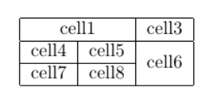
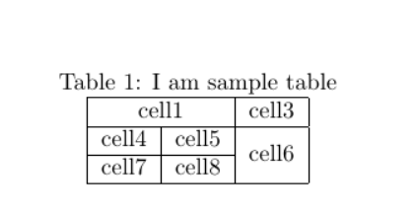
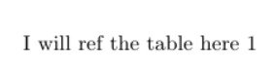
$LaTeX$ syntax
Table:
\begin{table}[] \begin{tabular}{|c|c|c|} % aligned \hline %line \multicolumn{2}{|c|}{cell1} & cell3 \\ \hline %merge line cell4 & cell5 & \multirow{2}{*}{cell6} \\ \cline{1-2} %merge column
cell7 & cell8 & \\ \hline \end{tabular} \end{table}
\begin{table}[] \caption{I am sample table} \label{tab1sample} \centering \begin{tabular}{|c|c|c|} \hline \multicolumn{2}{|c|}{cell1} & cell3 \\ \hline cell4 & cell5 & \multirow{2}{*}{cell6} \\ \cline{1-2} cell7 & cell8 & \\ \hline \end{tabular} \end{table}
I will ref the table here~\ref{tab1sample}

Slide 31
$LaTeX$ syntax
Table location control
h: where the table is declared (here)
t: at the top of the page
b: at the bottom of the page
p: on a dedicated page of floats
!: override the default float restrictions.
https://en.wikibooks.org/wiki/LaTeX/Tables

Slide 32
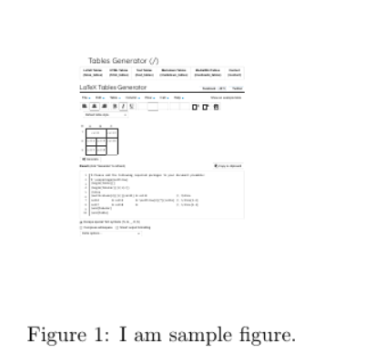
$LaTeX$ syntax
Image
\begin{figure}[!t] \centering \includegraphics[width=1.13in]{pic/1-1} \caption{I am sample figure.} \label{fig1sample} \end{figure}

Slide 33
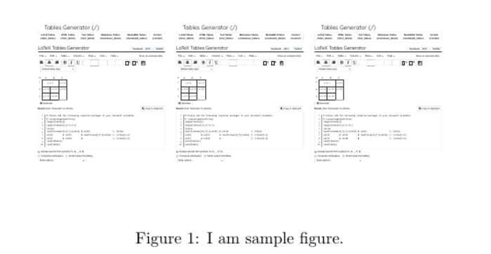
$LaTeX$ syntax
Multi Image
\begin{figure}[!t] \centering \includegraphics[width=1.13in]{pic/1-1} \includegraphics[width=1.13in]{pic/1-1} \includegraphics[width=1.13in]{pic/1-1} \caption{I am sample figure.} \label{fig1sample} \end{figure}

Slide 34
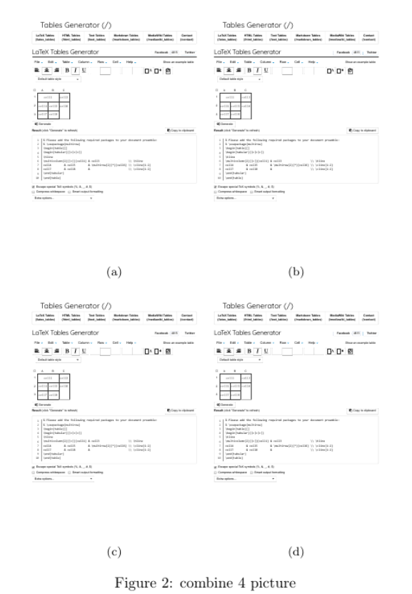
$LaTeX$ syntax
Multi Image with subtitle
\begin{figure}[!t] \centering \subfloat[]{ \includegraphics[width=1.6in]{pic/1-1} } \subfloat[]{ \includegraphics[width=1.6in]{pic/1-1} } \quad \subfloat[]{ \includegraphics[width=1.6in]{pic/1-1} } \subfloat[]{ \includegraphics[width=1.6in]{pic/1-1} } \caption{combine 4 picture} \label{fig2combine} \end{figure}

Slide 35
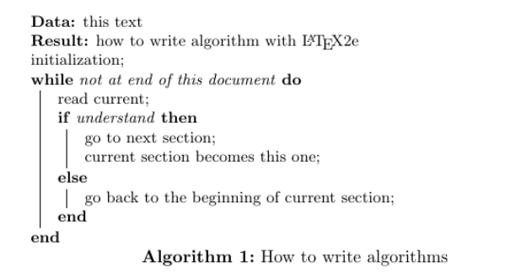
$LaTeX$ syntax
algorithm
\begin{algorithm}[H] \SetAlgoLined \KwData{this text} \KwResult{how to write algorithm with \LaTeX2e } initialization\; \While{not at end of this document}{ read current\; \eIf{understand} {go to next section\; current section becomes this one\;} {go back to the beginning of current section\;} } \label{Algorithmsample} \caption{How to write algorithms} \end{algorithm}

Slide 36
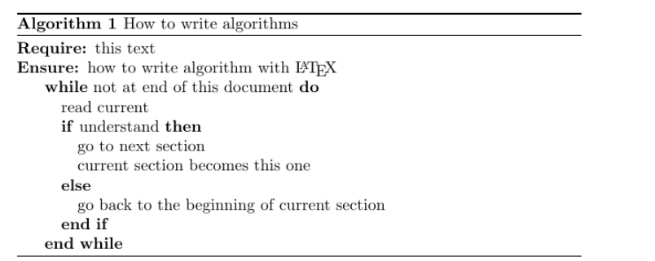
$LaTeX$ syntax
algorithm
\begin{algorithm} \caption{How to write algorithms} \label{algo2} \begin{algorithmic}[H] \REQUIRE this text \ENSURE how to write algorithm with \LaTeX \WHILE{not at end of this document} \STATE read current \IF {understand} \STATE go to next section \STATE current section becomes this one \ELSE \STATE go back to the beginning of current section \ENDIF \ENDWHILE \label{Algorithmsample} \end{algorithmic} \end{algorithm}

Slide 37
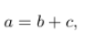
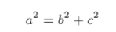
$LaTeX$ syntax
Equation
Inline : $a=b+c$
Equation block:
Non list equation: \[ a^2=b^2+c^2\]
Online
https://www.latex4technics.com/
https://www.codecogs.com/latex/eqneditor.php/
\begin{equation} \label{eq1} a^2=b^2+c^2 \end{equation}

Slide 38
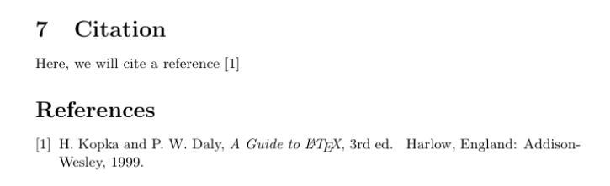
$LaTeX$ syntax
Reference
Using bbl
Using bib
Create by Zotero, Mendeley, etc.
\begin{thebibliography}{1} \bibitem{citekey} H.~Kopka and P.~W. Daly, \emph{A Guide to \LaTeX}, 3rd~ed.\hskip 1em plus 0.5em minus 0.4em\relax Harlow, England: Addison-Wesley, 1999. \end{thebibliography}
Here, we will cite a reference~\cite{citekey}

Slide 39

Zotero
Setup
Import library
Add new item
Plugins
Cite in Latex
Cite in Word
https://zbib.org/

Slide 40
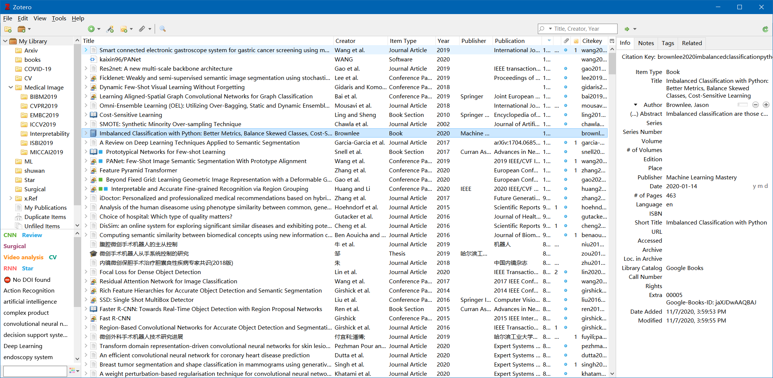
Zotero

Slide 41


Setup
Download https://www.zotero.org/download/
Zotero Connector https://chrome.google.com/webstore/detail/ekhagklcjbdpajgpjgmbionohlpdbjgc
https://www.zotero.org/support/zh/start

Slide 42
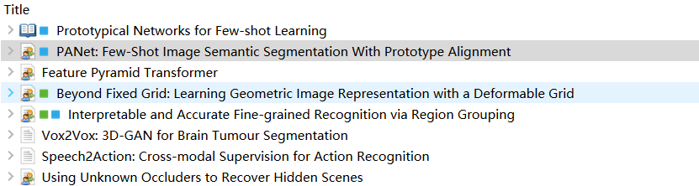
Item type
Book Section
Conference paper
Journal Article
Thesis
Book
Code

Slide 43
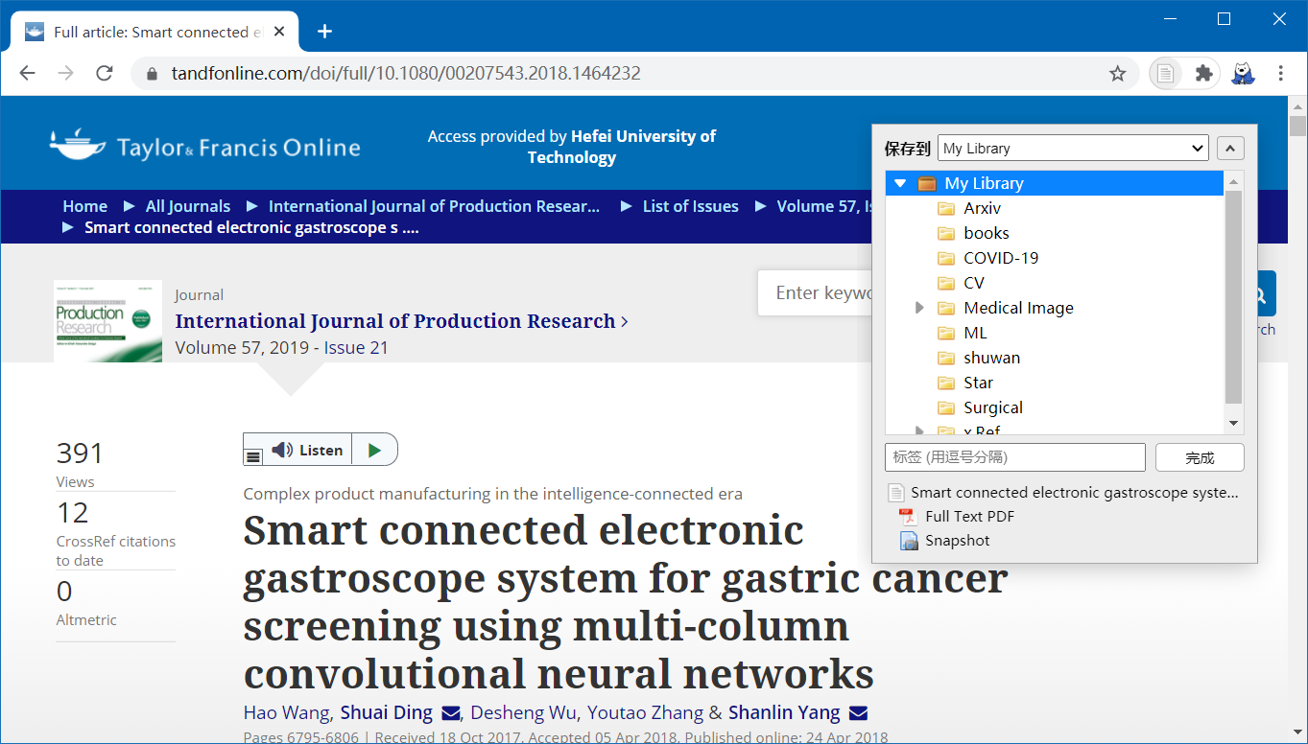
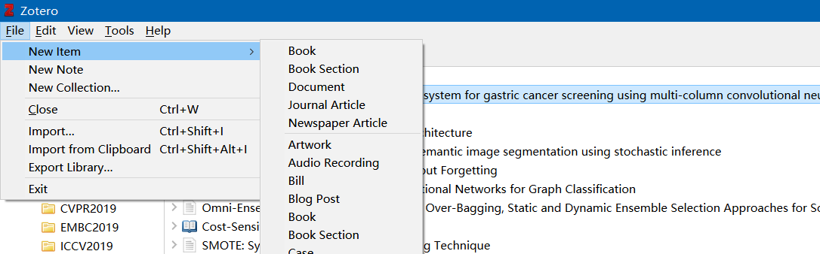
Add new item
From web
From client import
https://www.zotero.org/support/zh/start

Slide 44
Plugins
Better BibTex for Zotero
Make Zotero useful for us LaTeX holdouts.
Zotero DOI Manager
Zotero plugin for auto-fetching and validating DOI and shortDOI names
Zotero Scholar Citations
Zotero plugin for auto-fetching numbers of citations from Google Scholar
ZotFile
Advanced PDF management for Zotero

Slide 45

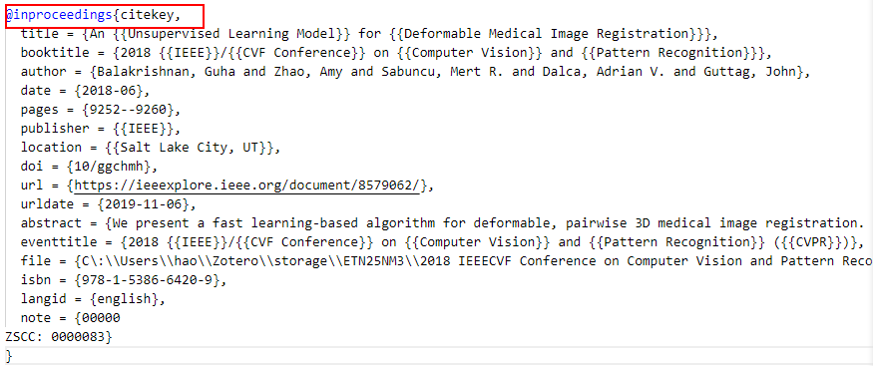
Cite in Latex
Export the collection
Cite item with citekey
Here, we will cite a reference~\cite{citekey}

Slide 46



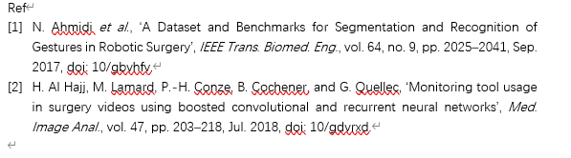

Cite in Word
Check word plugin
Add or edit citation
Add or edit bibliography

Slide 47
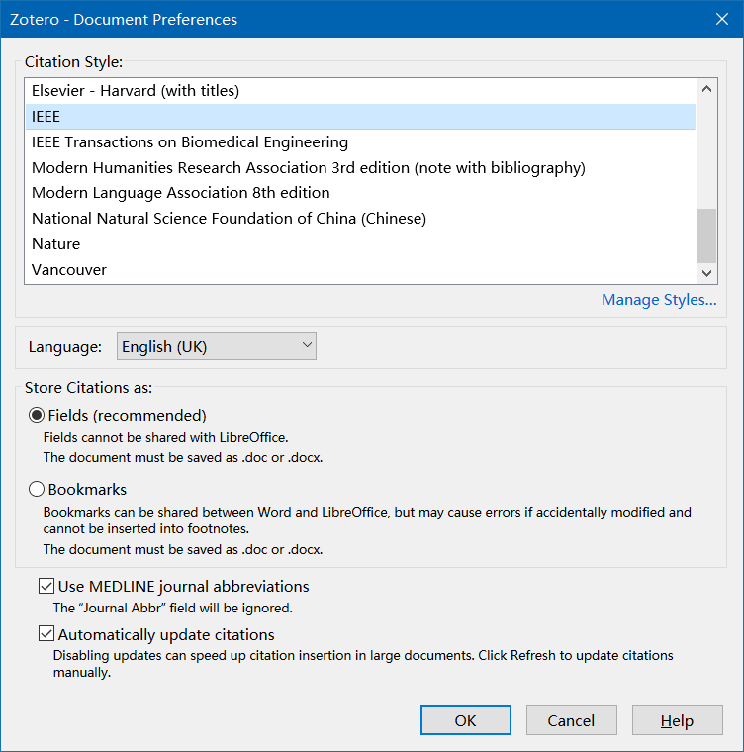
Select Cite style
Click documents preferences
Choose a preferred style
Refresh

Slide 48
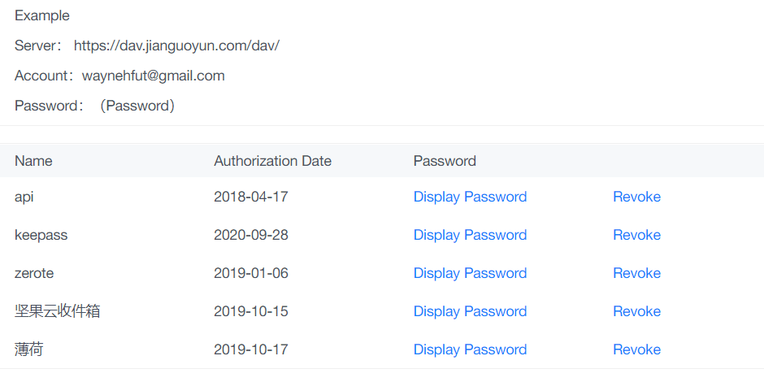
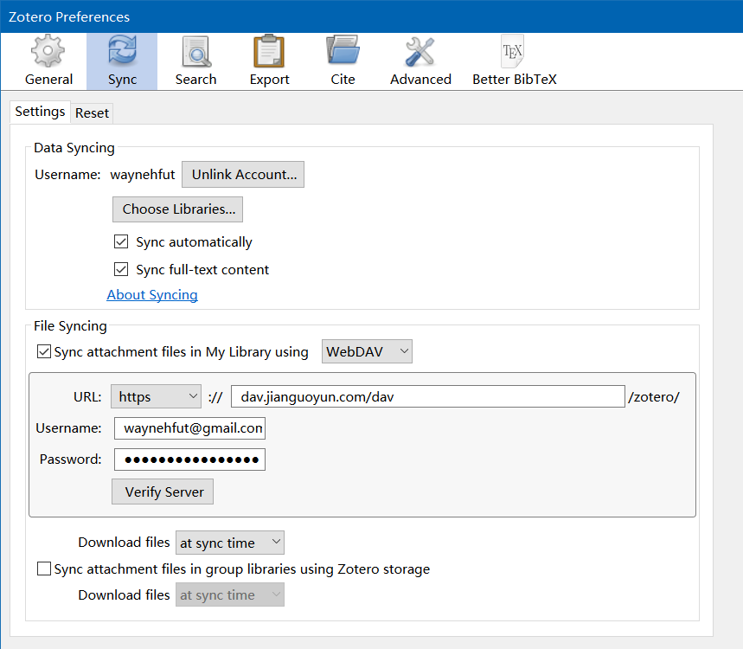
Sync with Zotero or WebDAV
Zotero provides cloud sync storage with 1GB
Consider using WebDAV to sync the library

Slide 49
Some useful link
Zotero中文教程
https://www.zotero.org/support/zh/quick_start_guide
LaTeX Wiki
https://en.wikibooks.org/wiki/LaTeX/Tables
使用LaTeX写论文
https://blog.waynehfut.com/2020/01/20/intro-to-tex/
20分钟学会使用Git
https://blog.waynehfut.com/2020/02/20/quickgittur/

Slide 50
Cheers!
Hao Wang
https://waynehfut.com

